Slide 1

STUDENT GRADE ANALYSIS
TEAM MEMBERS
Ruthwik Reddy[RA2011003010466]

Slide 2
ABSTRACT
In the world of open education systems, students have flexibility to learn anything with ease as the learning content is easily available. But this facility can make student complacent. Therefore, it becomes difficult to predict the student’s performance in advance. In this project, an attempt is made to help the student to know his performance in advance. This is done by using univariate linear regression model. This would help students to improve their performance based on predicted grades and would enable teachers to identify those individuals who need assistance. The Main Objective of “Student Grade Analysis and Prediction” is to implement a simple algorithmic model that predicts the score of an individual student at he /she end of the year.

Slide 3
LITERATURE SURVEY

Slide 4
S.No | Title | Author Name and Year of Publication | Methodology | Inference | Drawbacks
1. 2. 3. 4. 5. | Literature survey on student's performance prediction in education using data mining techniques. survey on various aspects of education data mining in predicting student performance A machine learning algorithm framework for predicting students performance systematic review on educational data mining. | Kumar M,2017 Shingari I,2018 Qazdar A,2018 Dutt A,2018 | students performance prediction predicting students performance predicting students perfomance by machine learning educational data mining | Important factors of students used for predicting students' performance Accuracy of different prediction models Education Data Mining (EDM) is an interdisciplinary straightforward field to investigate that handles the advancement of strategies we present a framework for predicting student performance based on Machine Learning algorithm This implies that a preprocessing algorithm has to be enforced first and only then some specific data mining methods can be applied to the problems

Slide 5
Comparison of Existing methods with merits and demerits
EXISTING SYSTEMS | MERITS | DEMERITS
Standardized Exams | Reduces or eliminates faculty time demands in instrument development and grading. | Unlikely to match the specific goals and objectives of a program/ institution
Locally Developed Exams | Specific criteria for performance can be established in relation to the curriculum. | May hinder curriculum change if it means that exam would have to be revised.

Slide 6
Challenges to address
Grading sends a direct message to students about what is expected in class. However, often there is a gap between the assigned grade and the goals of the instructor. In an interview study of faculty teaching calculus-based introductory physics, we verified that this gap exists and identified three themes that appear to shape grading decisions: (1) a desire to see student reasoning, (2) a reluctance to deduct points from a student solution that might be correct, and (3) a tendency to project correct thought processes onto a student solution. When all three themes were expressed by an instructor, the resulting conflict was resolved by placing the burden of proof on either the instructor or the student. The weighting of the themes with the burden of proof criterion explains our finding that although almost all instructors reported telling students to show their reasoning in problem solutions, about half graded problem solutions in a way that would likely discourage students from showing this reasoning.

Slide 7
Problem Statement and Objectives
The problem statement can be defined as follows ”Given a dataset containing attribute of 396 Portuguese students where using the features available from dataset and define classification algorithms to identify whether the student performs good in final grade exam, also to evaluate different machine learning models on the dataset.”
The Main Objective of “Student Grade Prediction Application” is to implement a simple algorithmic model that predicts the score of an individual student at he /she end of the year. “G3” or the final grade is our label (output) and the rest of the columns will be our features (inputs).

Slide 8
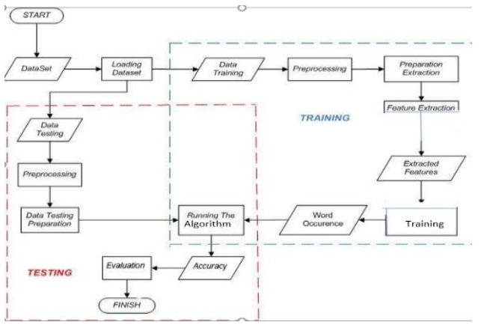
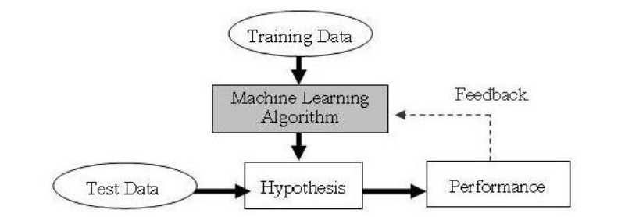
Architecture/Block Diagram of the Proposed model

Slide 9
Modules Description and Implementation
Let’s consider a school and data of its students. We collect every single minute information about the students and we put in an excel file. This gives a shape to the data. Suppose that we have around thirty three different attributes or features of data that we collected for every student. The first step in our process is identifying the attributes. We should now consider only those attributes that depend on the Grade of the student. To find out these attribute we should find correlations. Correlations give the dependency of a dependent variable on an independent variable. We then consider only the attributes that are mostly related and discard the rest. We then change the data types of the file as the system cannot compute multiple data types at once. So we convert the data type of the file and send it for training and testing. In training and testing, the data is partitioned randomly for training and testing. The partitions are sent for training and testing respectively. Then, it sent for a fit function using Linear Regression algorithm. The result is then predicted and the result obtained is the final grade (G3). For portraying accuracy it is shown using Boxplot.

Slide 10
References
1. Alshammari, R., & Khan, S. U. (2018). Machine Learning Techniques for Educational Data Mining: A Survey. IEEE Access, 6, 53409-53427.
2. Bawaneh, S. S. (2019). A Comparative Study on Classification Models for Predicting Student Performance. Journal of Educational Computing Research, 57(5), 1139-1159.
3. Chakraborty, T., Chakraborty, S., & Das, R. (2021). Predictive analytics of student academic performance using machine learning: A review. Journal of King Saud University-Computer and Information Sciences, 33(1), 77-89.

